Slide 1
Interpretation of the Lunar Surface Evolution Combining Space Weathering and Impact Gardening
Kilho Baek^{1,⁕}, Sungsoo S. Kim¹, and Chae Kyung Sim^{2,3}
¹ Kyung Hee University
² Korea Astronomy and Space Science Institute (KASI)
³ Korea National University of Science and Technology (UST)
⁕ PhD Candidate

Slide 2
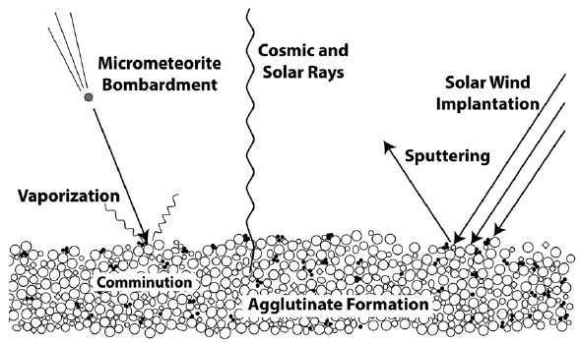
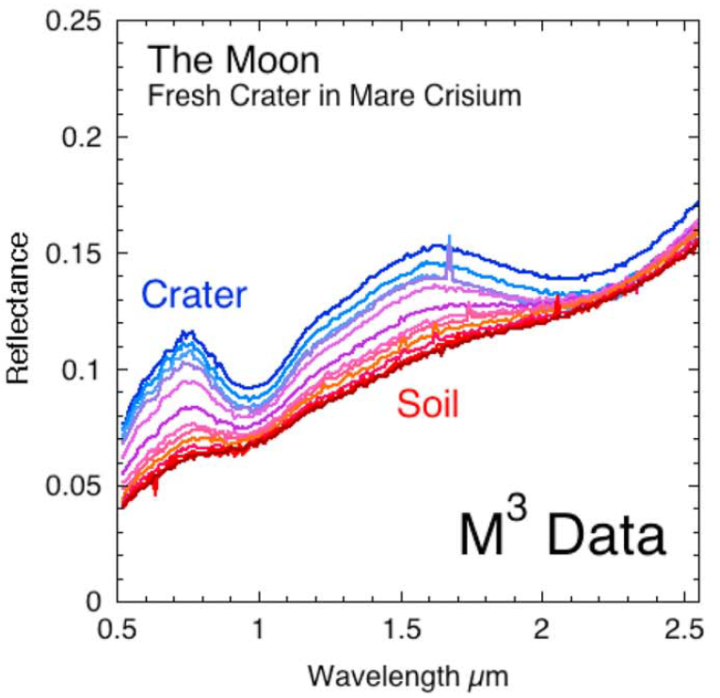
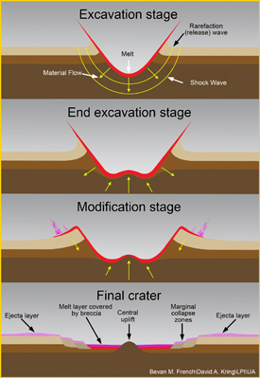
Background: Evolution of the Lunar Surface
Space Weathering
Impact Gardening
Pieters & Noble (2016)
Pieters & Noble (2016)
Space Weathering
Fresh
Regolith
Mature
Regolith
Impact Gardening

Slide 3
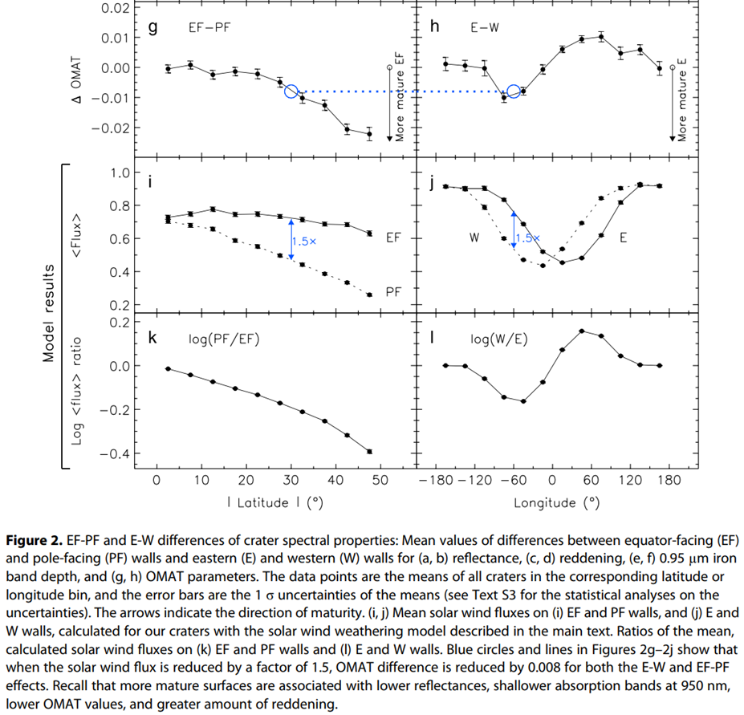
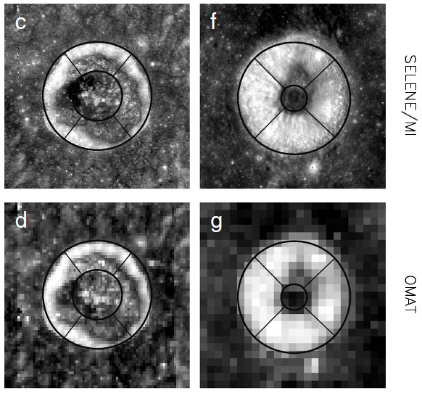
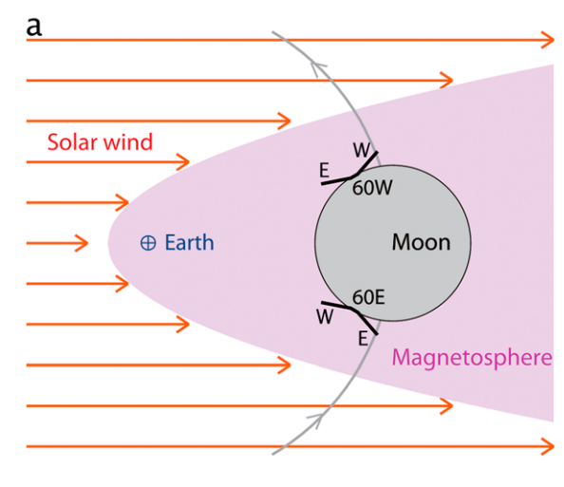
Overview: Previous Study
OMAT = Optical Maturity
Sim et al. (2017) GeoRL
North
Equator
Facing
North
Pole
ΔOMAT
West
East
Log<flux> ratio
Pole
Facing
South
Equator
Lat.
| Latitude | (°)
Longitude (°)
North
Pole
Facing
N
Stronger
Flux
EF wall
West
East
solar wind
PF wall
Equator Facing
South
Pole
Same Flux
Lat.
South
Equator

Slide 4
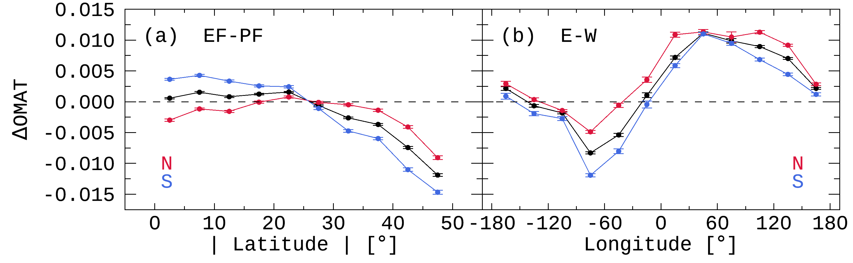
Overview: This Study
Sim et al. (2017)
> 1,872 craters
This Study
> 26,802 craters
The latitudinal and longitudinal trends analyzed by dividing into the N and S hemispheres
New
Findings
Hemispheric asymmetry
Longitudinal offset
Space weathering (solar wind particles)
Impart gardening (meteoroids)

Slide 5
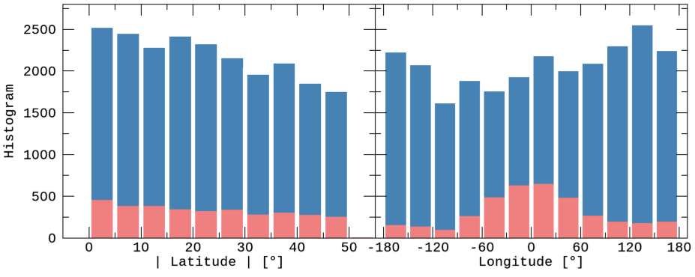
Data
Lunar Impact Crater Database
Global Map
 | LPI (2015) | Robbins et al. (2018)
Total Number | 8716 | ~1.3 million
Main Information | Latitude & Longitude
 | Diameter | Major/Minor-axis
 | Topography | Photometry
Data | DEM (Digital Elevation Model) | Reflectance (415 ~ 1550 nm)
Instrument | LRO LOLA + Kaguya TC | Kaguya MI
Latitude | -60° ~ +60°
Resolution | 512 ppd (≈ 60 m/pixel)
(for the comparative verification)
(for detailed analysis)
Extended Crater Sample
2018 DB
2015 DB
 | Sim et al. (2017) | This study
Database | LPI 2015 |  | Robbins et al. (2018)
Samples | 1,872 | 3,144 | 26,802
Resolution | ~1 km/pixel | ~60 m/pixel
Diameter | 5 ~ 120 km |  | 2 ~ 120 km

Slide 6
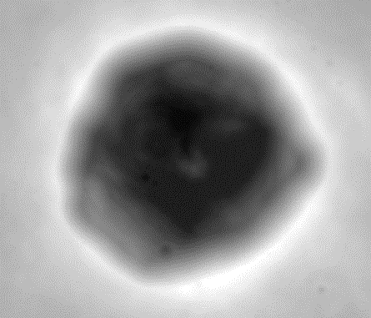
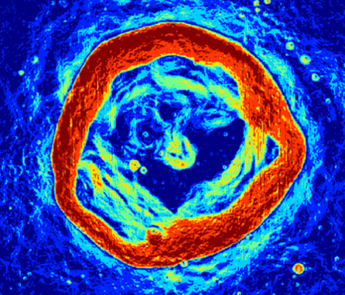
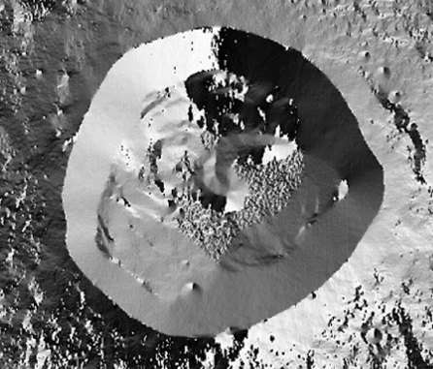
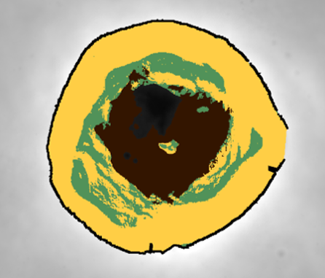
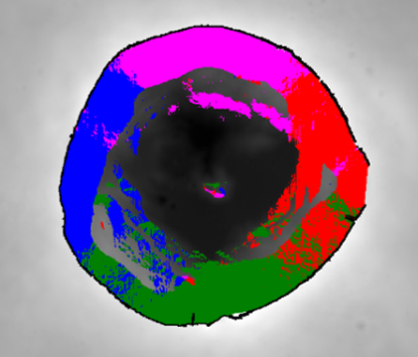
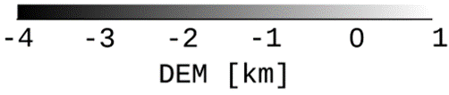
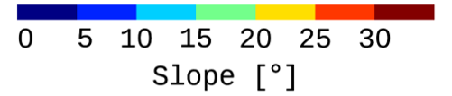
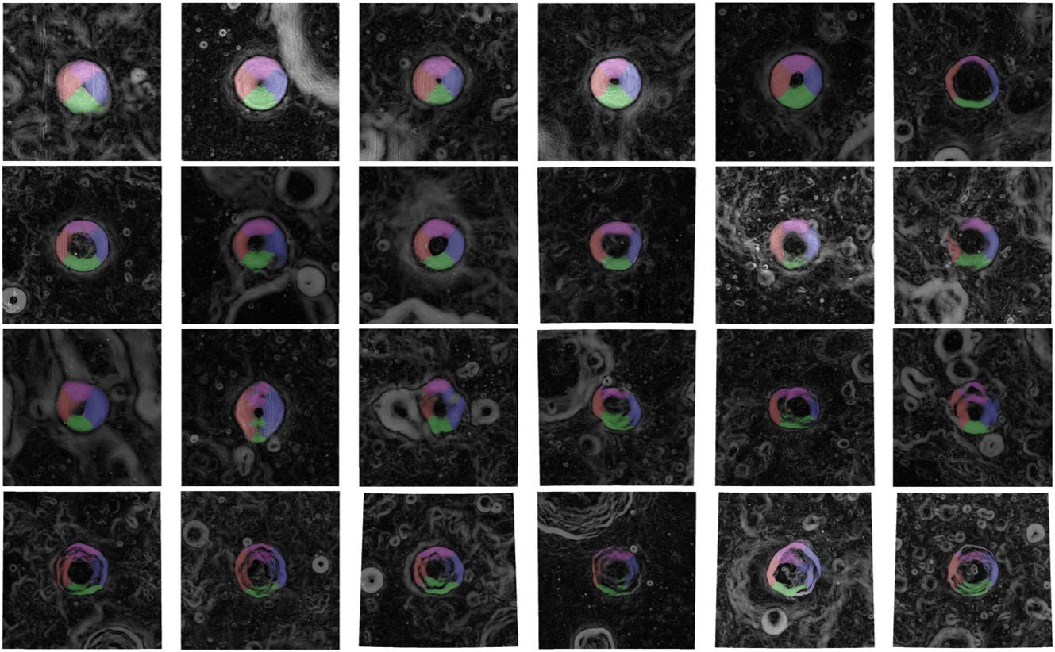
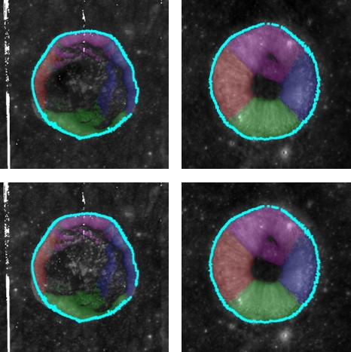
Data Processing
DEM [km]
Slope [°]
Azimuth Angle [°]
Inner Structures
Wall-Quadrants
rim
3D vector
calculation
DEM
Slope
Azimuth
-4
-2
0
0
10
20
30
-180
0
180
Floor
Terrace
Wall
W
N
S
E
Sim et al. (2017)
This study
Simple
Complex

Slide 7
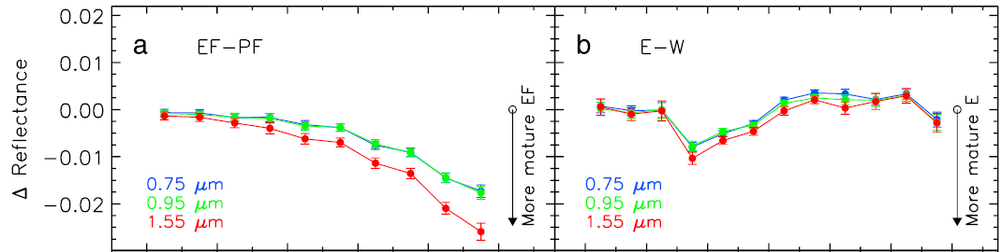
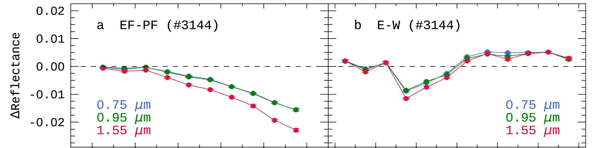
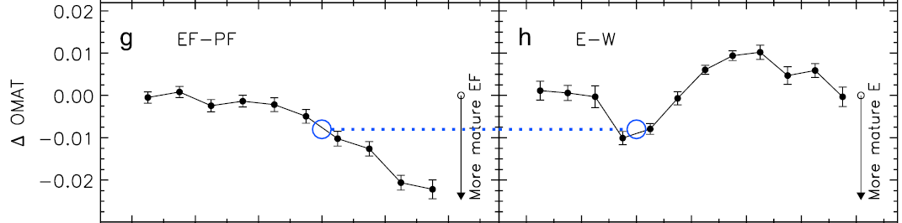
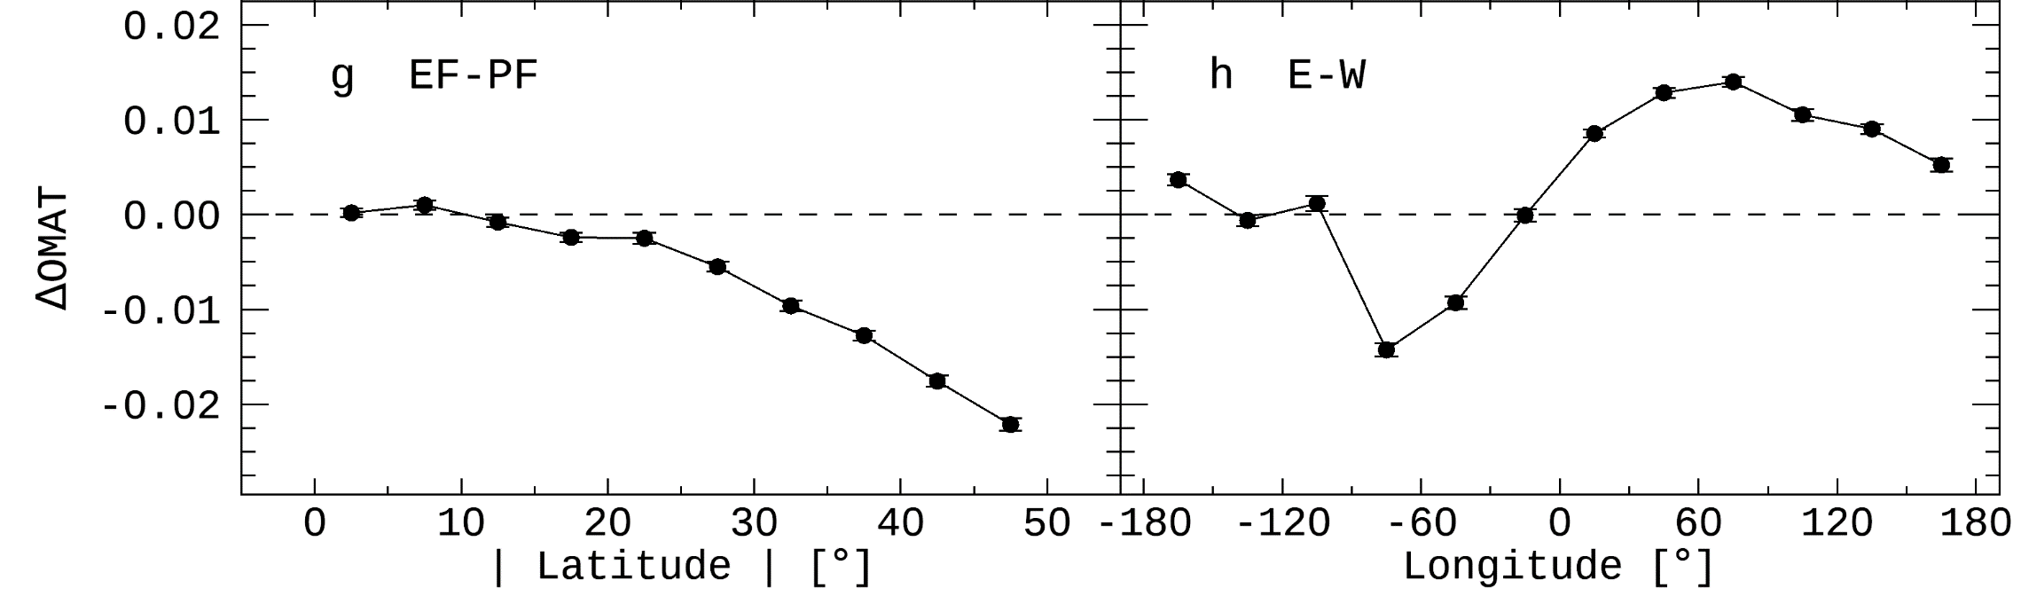
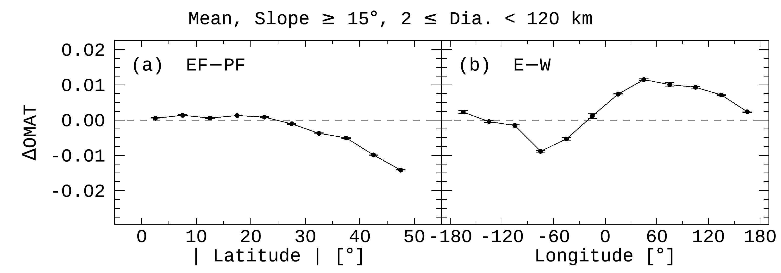
Results: Algorithm Verification
Reproducing the Previous Study [Sim et al. (2017) GeoRL]
Sim et al. (2017): 2015 DB > 1,872 craters
This study : 2015 DB + improved algorithm > 3,144 craters
This study : 2018 DB + improved algorithm > 26,802 craters

Slide 8
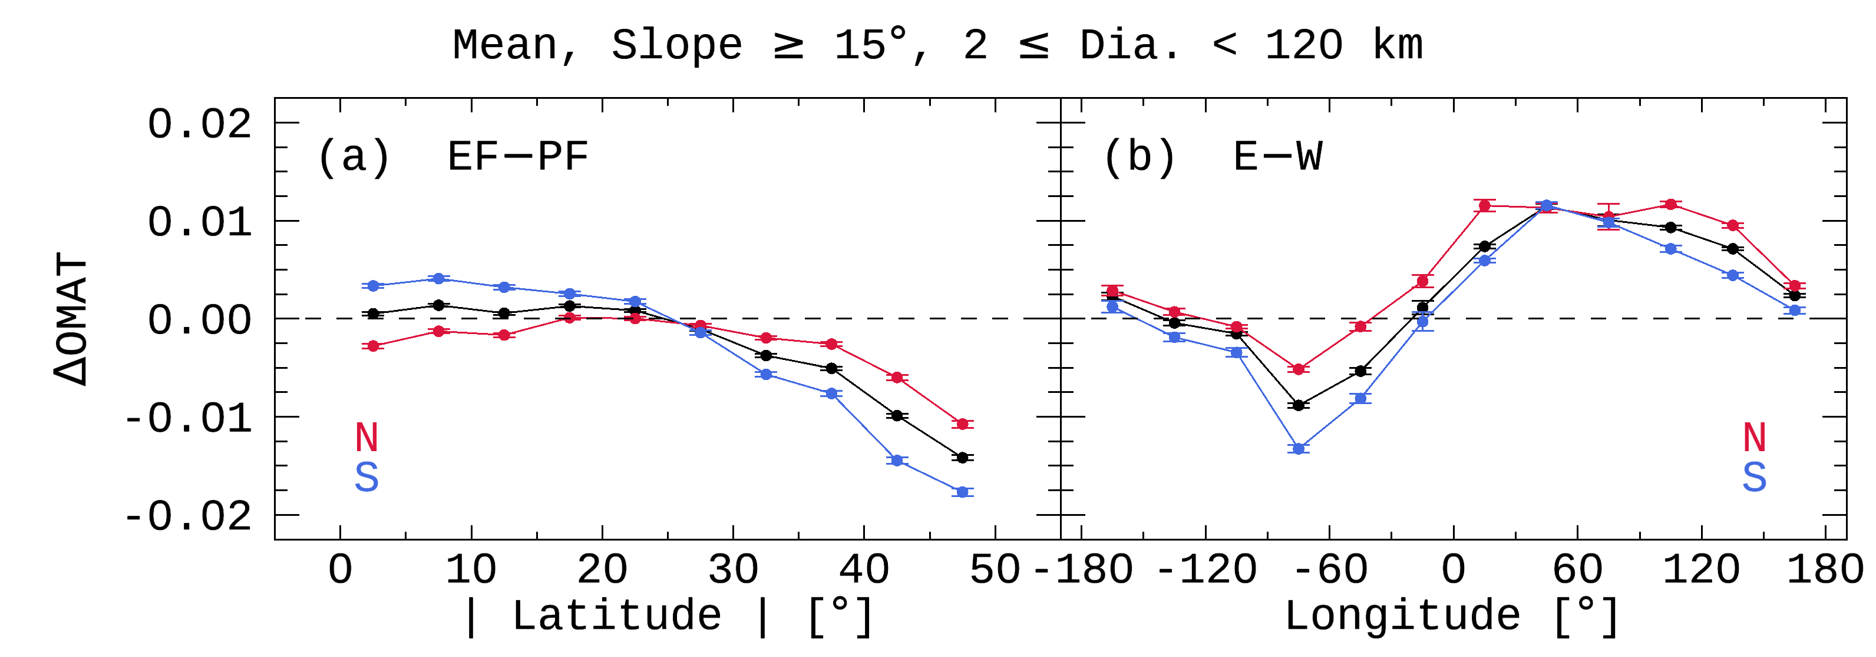
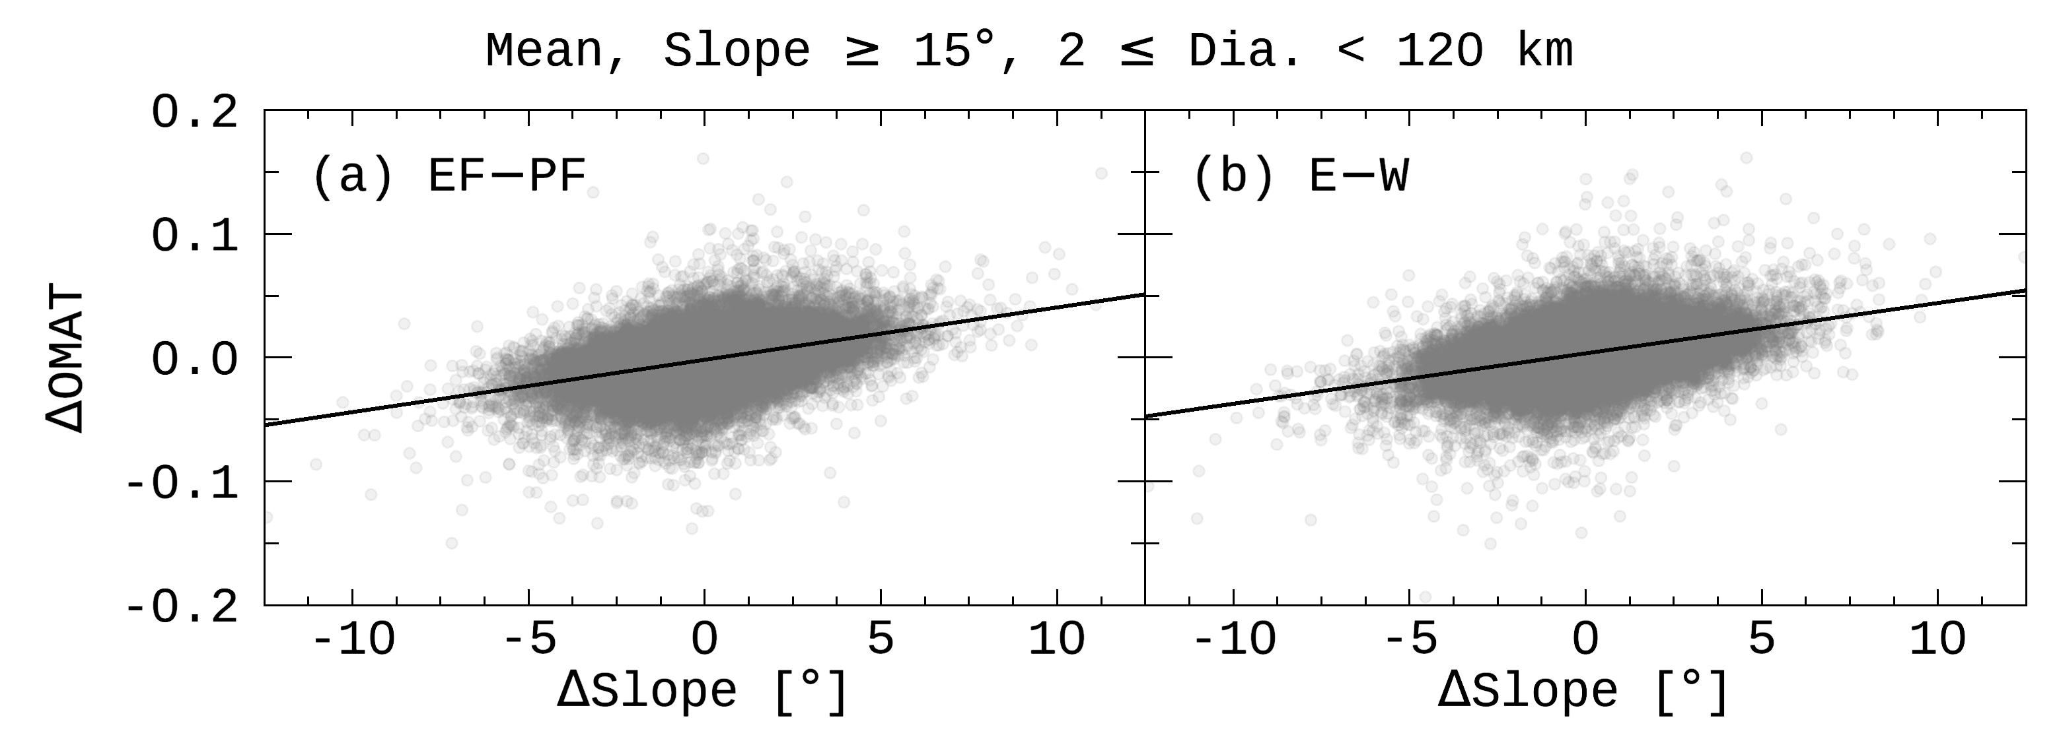
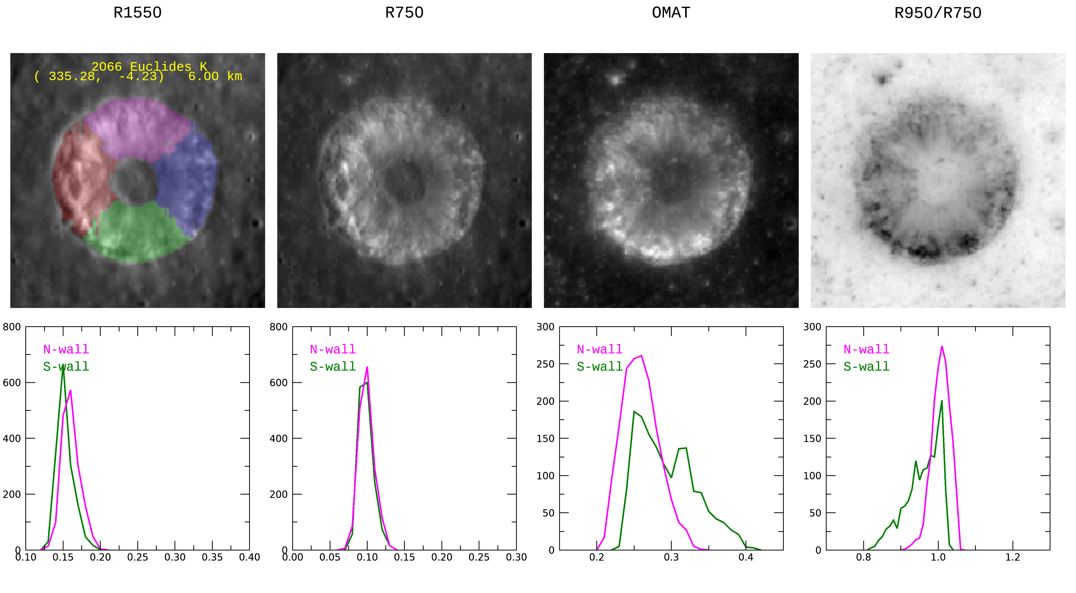
Results: Northern & Southern Hemispheres
① Hemispheric Asymmetry
➔ [Something] makes ➔- S wall fresh near the equator.
① Hemispheric Asymmetry
➔ [Something] makes ➔? S wall fresh near the equator. ➔? N wall mature near the equator.
①
②
② Longitudinal Offset
➔ [Something] makes ➔- E wall fresh at any longitude.
② Longitudinal Offset
➔ [Something] makes ➔? E wall fresh at any longitude. ➔? W wall mature at any longitude.
?
[Something] = Meteoroids
Stronger
Flux
N
EF wall
solar wind
PF wall
crater wall
surface
Same Flux
Lat.
impact
Equator
➔ A wall with a steeper slope is fresher than the opposite wall.
terrace
average Slope
average OMAT
Mature
Fresh
Mature
Fresh
OMAT
OMAT

Slide 9
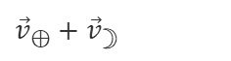
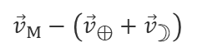
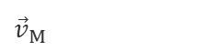
Meteoroid Environment near the Moon
① Meteoroids make
① S wall fresher than N wall near the equator.
② Meteoroids make
② E wall fresher than W wall at any longitude.
N-Pole
${\vec{v}}_{⊕}+{\vec{v}}_{☽}$
6 h
${\vec{v}}_{M}$
${\vec{v}}_{M}−\left({\vec{v}}_{⊕}+{\vec{v}}_{☽}\right)$
Daytime
Nighttime
N wall
28.76
W wall
E wall
30.80
Moon
46.74
Moon
48.51
Lat.
26.65
26.65
Equator
Helion
Equator
Anti-Helion
E wall
N-Pole
W wall
S wall
S-Pole
18 h
Meteoroid Flux: S wall > N wall
Meteoroid Flux: E wall > W wall

Slide 10
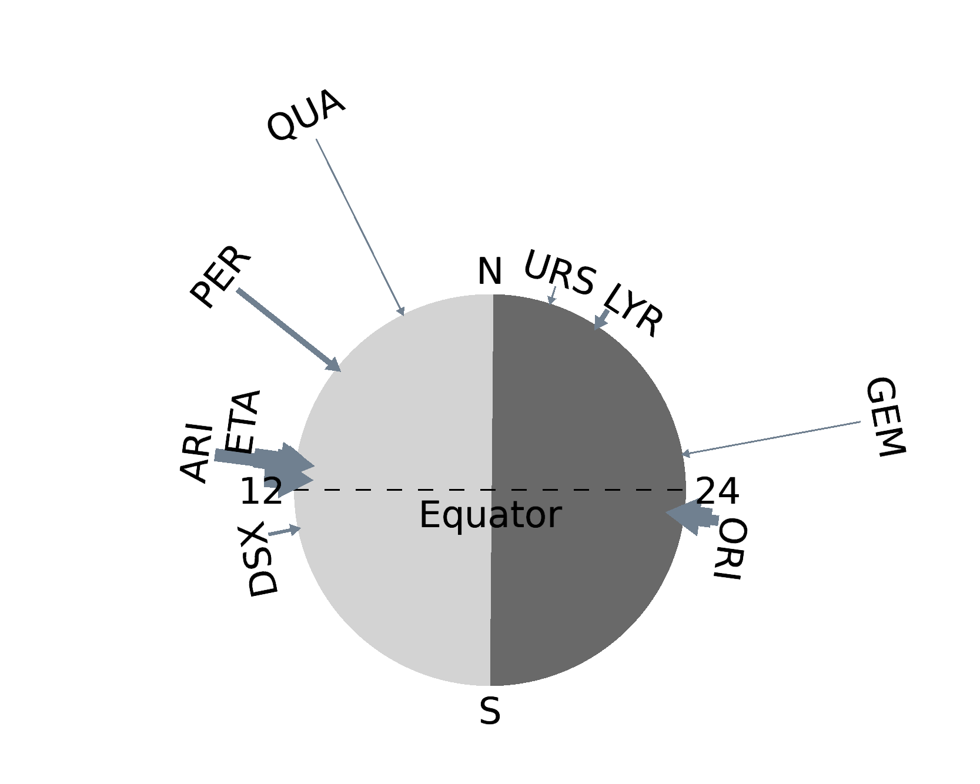
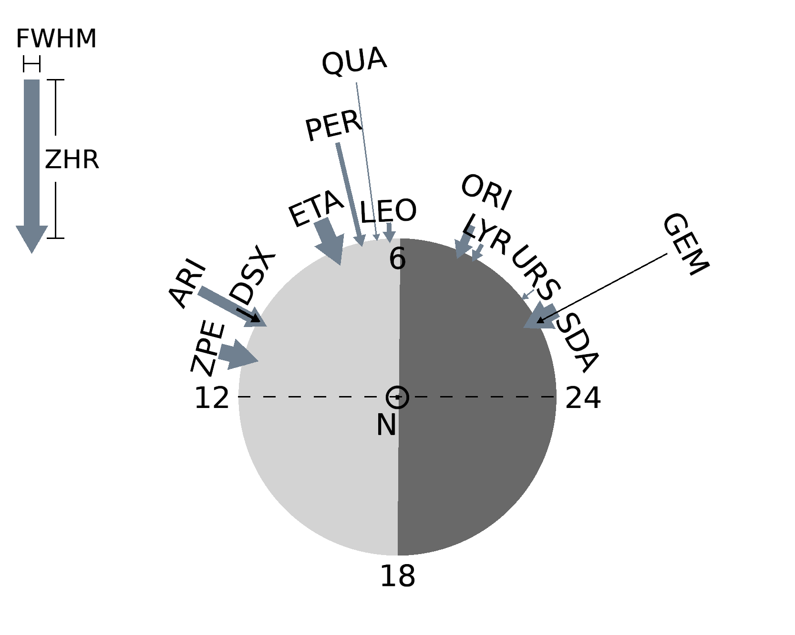
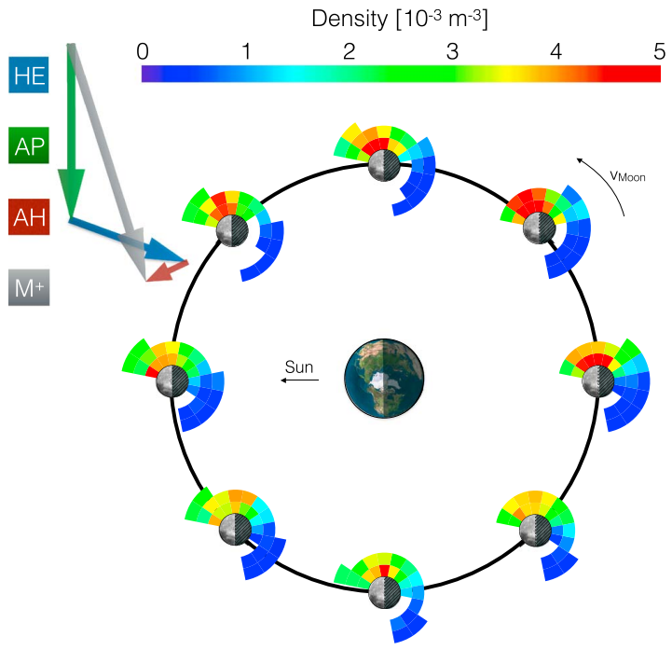
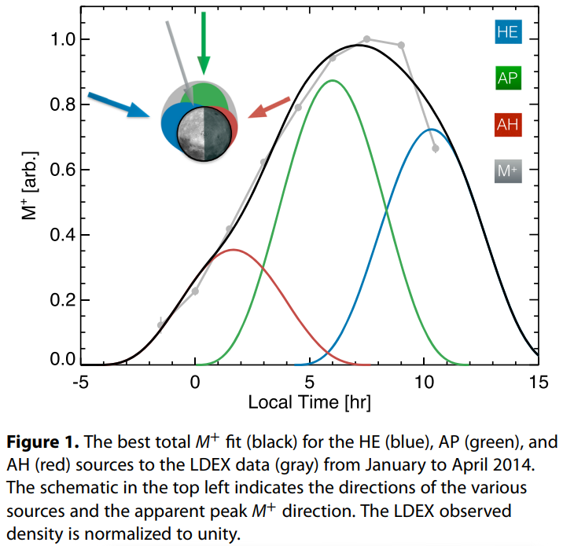
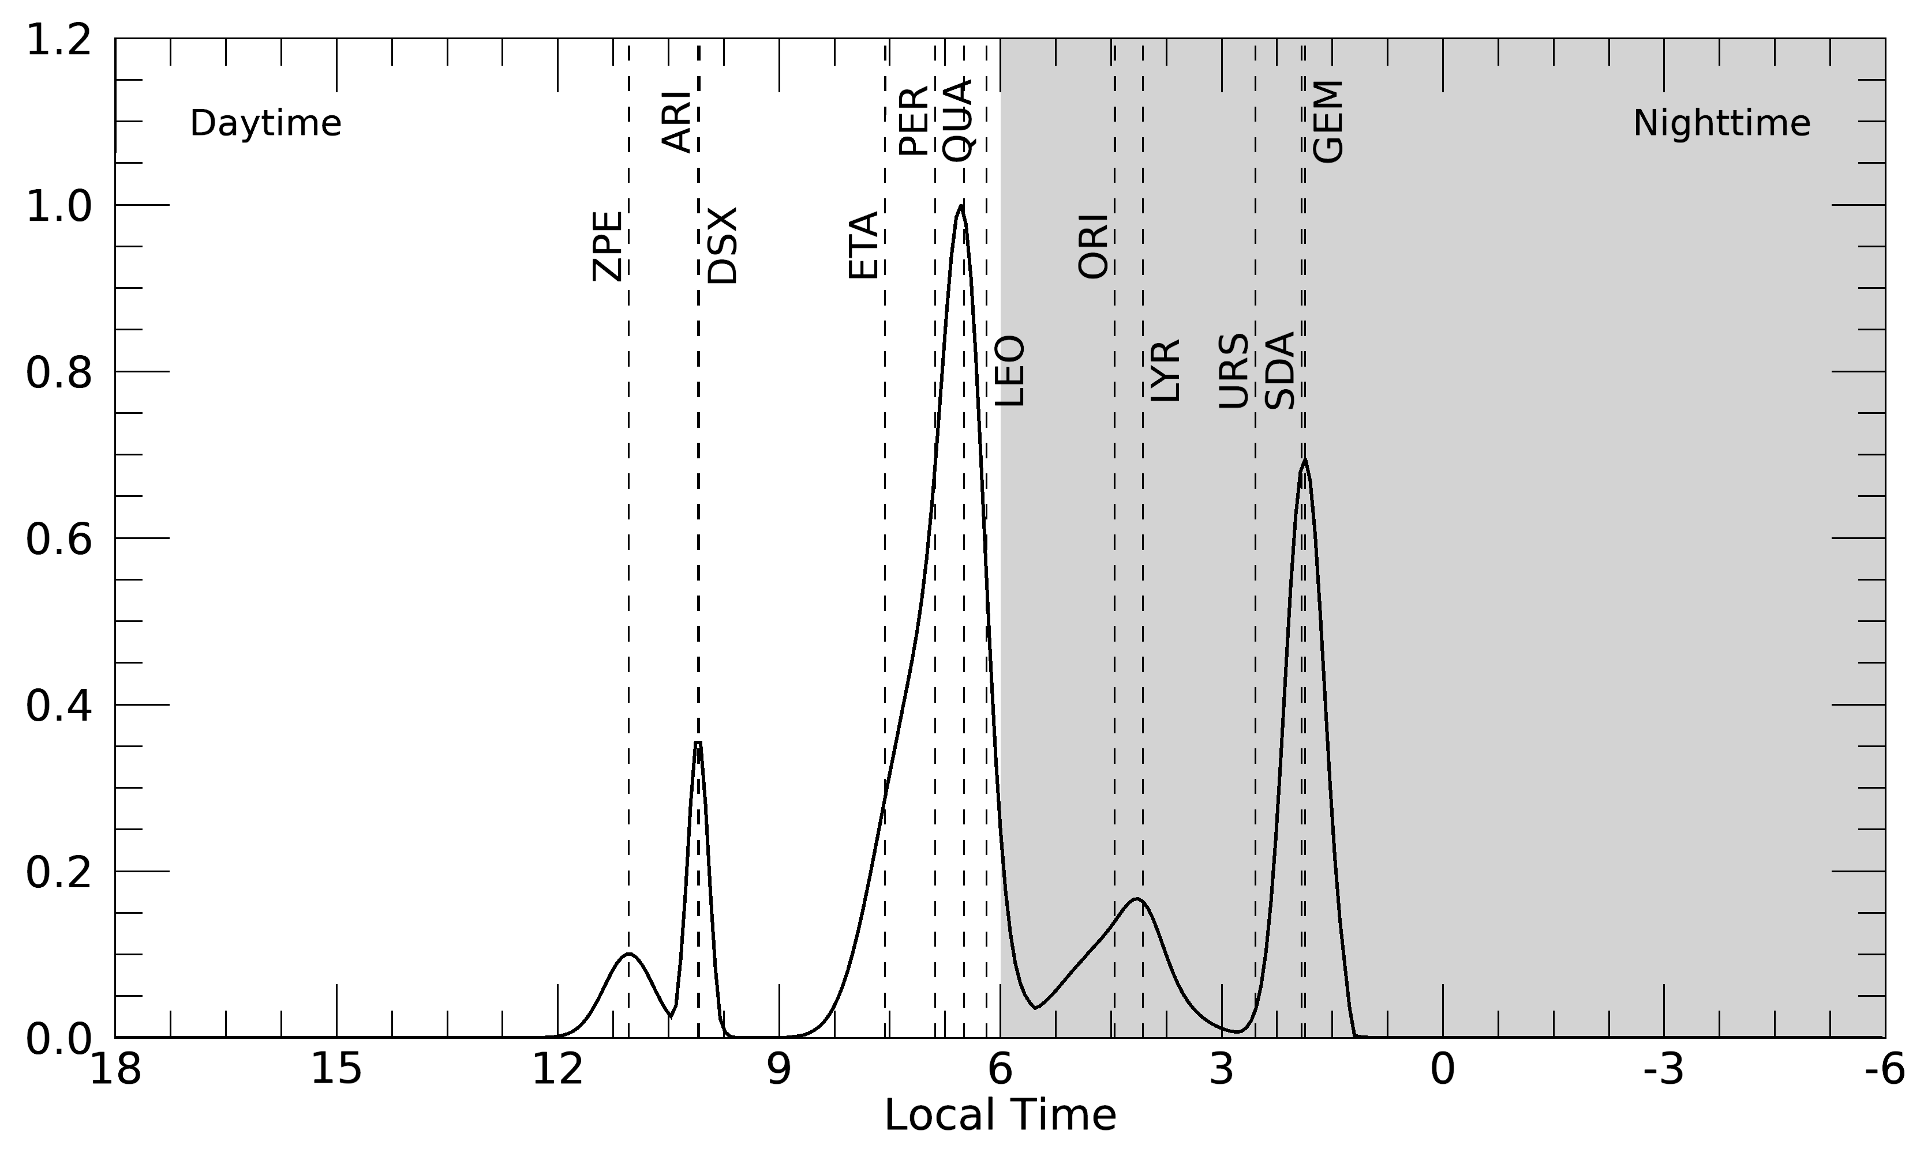
Meteoroid Environment near the Moon
Meteor Showers
Sporadic Meteoroids
Refer to the Tab. 7 of Merisio & Topputo (2023)
Szalay & Horányi (2015) GeoRL

Slide 11
Modeling: Solar-Wind + Meteoroids
Simple Model (Sim et al., 2017)
> Solar-wind particles
> - Earth’s magnetosphere
+ Orbital motion of the Earth
+ - Average speed ≈ 29.78 km/s
+ Sporadic meteoroids (Szalay & Horányi, 2015)
+ - Helion, Anti-helion, Apex
+ - Ecliptic lat. the radiant ≈ 0°
+ - Flux: Helion > Anti-Helion
+ Meteor showers (Merisio & Topputo, 2023)
+ - 12 major showers
+ - Ecliptic lat. the radiant ≈ 30°
+ - Flux: Helion > Anti-Helion
Apex
W
E
E
W
W
E
W
E
Helion
Anti-Helion
E
W
E
W
Solar wind
29.78
km/s
W
E
⊕
Earth
W
E
Shower
Moon
Moon
Shower
E
W
E
W
Magnetosphere
W
E
W
E
E
W
E
W
W
E
E
W
1.02 km/s

Slide 12
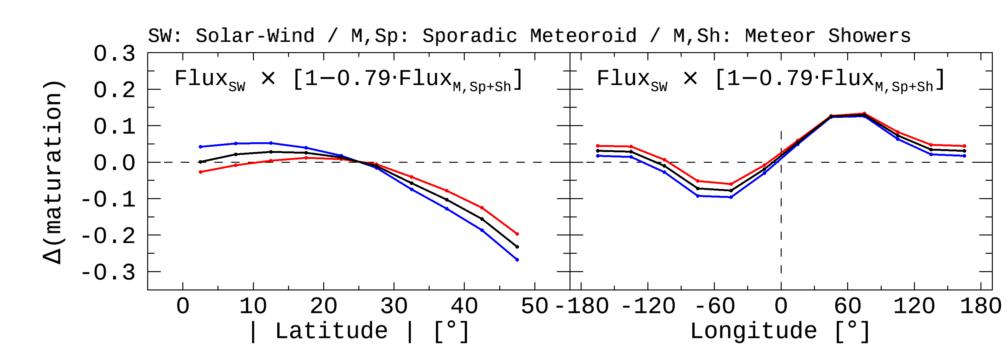
Modeling: Solar-Wind + Meteoroids
Observation
Our Model

Slide 13
Summary
Improvements (1) Data processing has been improved to define realistic features of a crater. (2) The number of craters available for analysis was extended from 1,872 to 26,802. ➔ We ensured statistical significance by reproducing the previous study.
New Findings & Modeling (1) N-S hemispheric asymmetry << Meteor showers (2) Longitudinal offset << Meteor showers & Sporadic meteoroids ➔ We are combining the effects of space weathering by solar-wind and impact gardening by meteoroids.
Earth’s orbital motion
Flux: Helion > Anti-helion
Impact Gardening |  | Space Weathering
Meteoroids |  | Solar-Wind Particles | Micrometeoroids
Sporadic Meteoroids | Meteor Showers
Excavation or Gardening (fresh soils come up to the surface) |  | Sputtering |  | Comminution (grain size become smaller)
 |  | (npFe) | (npFe & mpFe)
Refreshment |  | Maturation | Maturation
This study
Future Work
(w. PolCam onboard Danuri)

